Slide 1
Creating Your Community
Colorado’s Social Archive

Slide 2
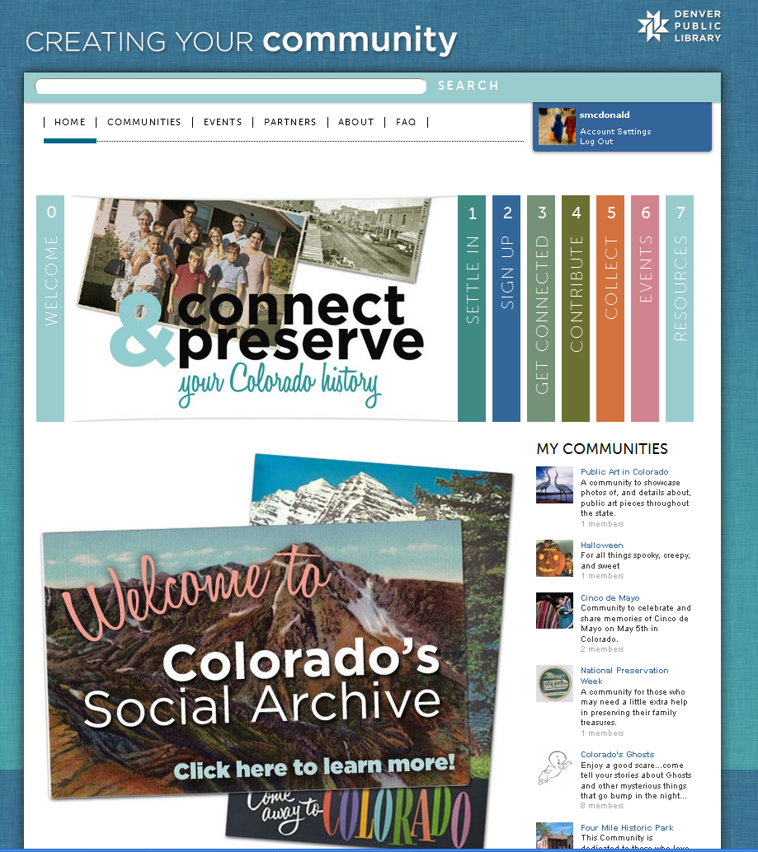
Project Overview
Institute of Museum and Library Services (IMLS) -National Leadership Grant

Slide 3
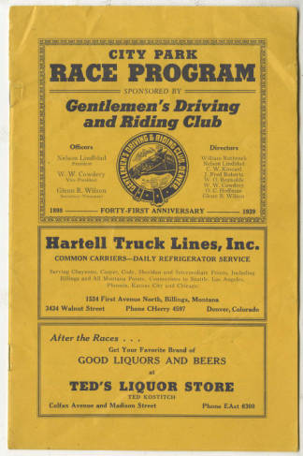
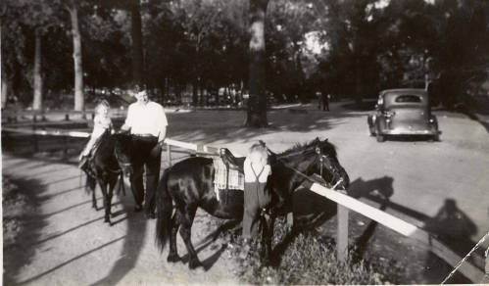
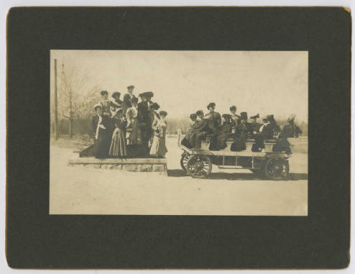
Capture the undocumented history of Colorado by providing a platform for different communities to share their histories and connect with other communities.
Denver City Park

Slide 4
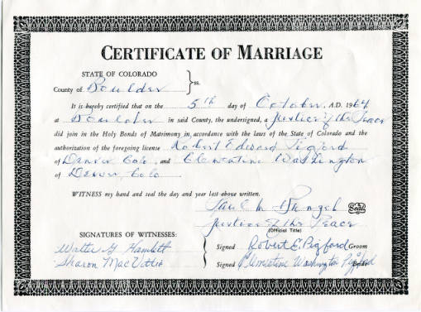
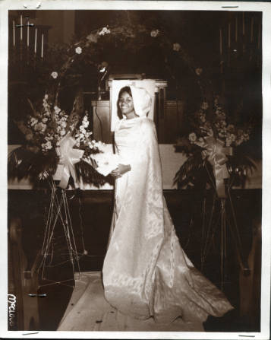
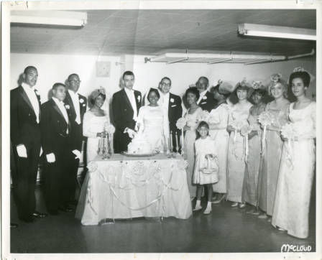
Provides public way to share their stories without giving up their personal treasures

Slide 5
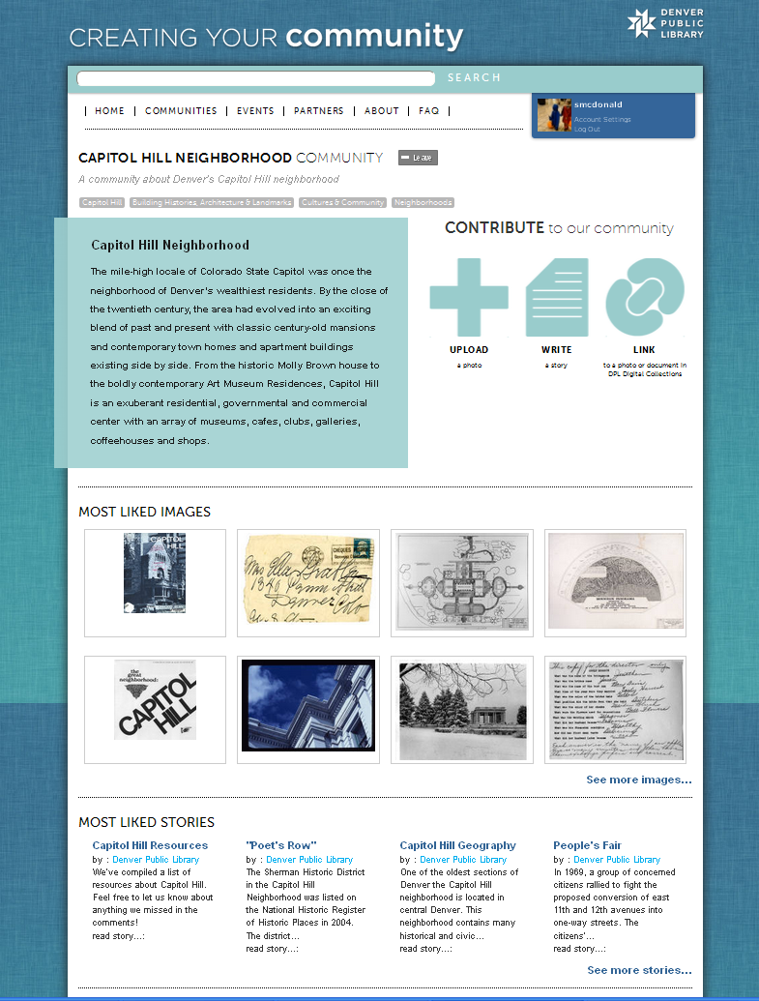
How it works
Users can:
- Create their own community
- Upload their own photos
Which will be added to our digital collections for future research
-Post their own stories
- Add items from our existing digital collections

Slide 6
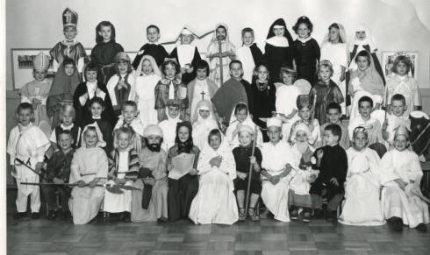
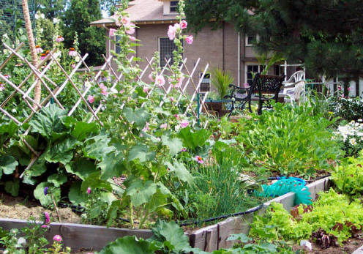
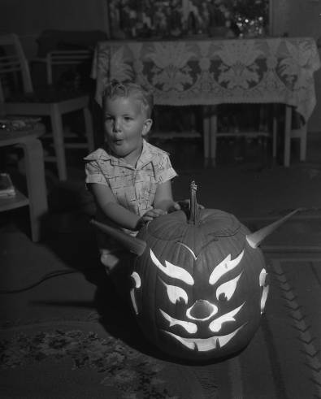
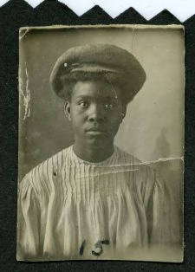
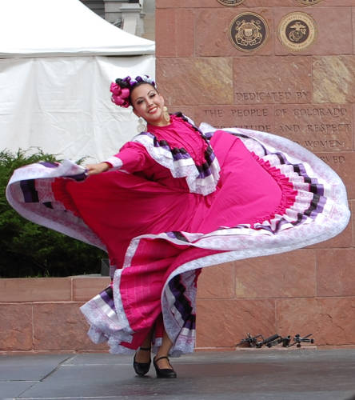
Examples of Communities/Added Content
Gardening
Holidays
Food
Neighborhoods
Schools
Churches
Fashion
Family Histories
Town Histories

Slide 7
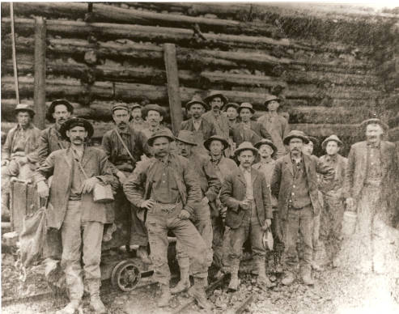
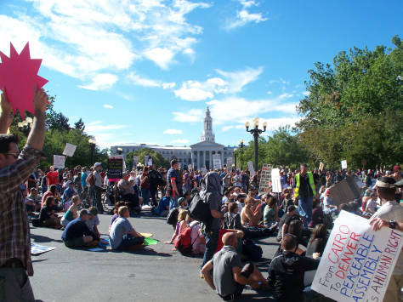
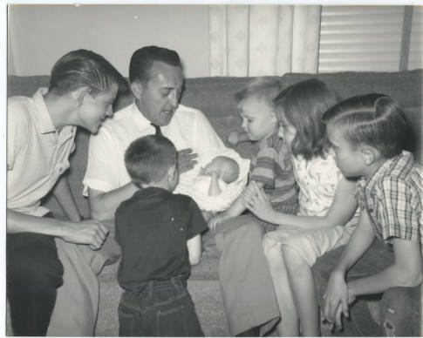
Lessons Learned
User’s Don’t:
- Have the time/energy
- Have the tech knowledge
- Don’t understand the concept
- Don’t feel like they have a story to share

